Slide 1

Python - Lists
5th Year Computer Science – January 2022

Slide 2

Course Outline
Lesson 1.
- What is a list?
Initialise a list
Understand the difference between a list and an array
Index a list
Lesson 2.
Recap on last class skills
Change the values in a list
Understand “Out of Range errors”
Use Negative indexing with lists
-
Lesson 3.
Recap on negative indexing
Implement different forms of list slicing
Understand and use different list methods-

Slide 3

Today we will cover these skills:
Understand what is a python list
Initialise a list
Understand the difference between a list and an array
Index a list

Slide 4
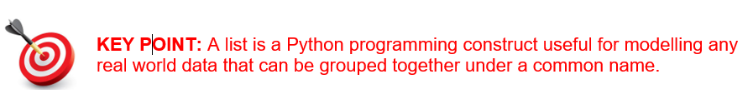
What is a list ?
Up until now, variables have been used to store single values. This has been the case regardless of the variable’s datatype i.e. whether it is a string or numeric, only one value at a time can be stored in it.
A list is a collection of variables.
The main purpose of lists is to store a collection of data items. Examples of lists include teacher names, schools, subjects, teams, lists of friends, a book list, a list of tweets, play lists (songs), shopping lists, a list of instructions, lists of countries etc…

Slide 5
Create a list in python
The simplest kind of list is an empty list i.e. contains no elements
boysName=[ ]
girlsName=[ ]
NB -> Lists are mutable. They can be updated at a later stage

Slide 6
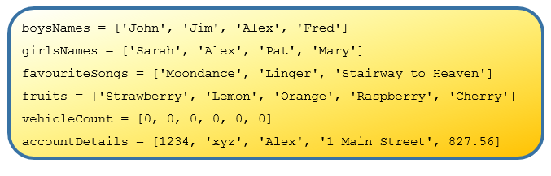
Initialise a list with data
The following snippet of code shows how to initialise lists with data.

Slide 7
Note the use of square brackets on the right hand side and the use of commas to separate the individual list elements. The number of elements in the lists are 4, 4, 3, 5, 6 and 5 respectively.
Notice also that boysNames, girlsNames, favouriteSongs and fruits are all lists of strings; vehicleCount is a list of numbers, and accountDetails is a list of different datatypes.

Slide 8

Difference between a list and an array
The list type is commonly referred to as an array in other programming languages.
One of the key differences between lists and traditional arrays used in other programming languages is that a Python lists can be made up of data having a mixture of different datatypes, whereas the elements of an array must all be of the same data type.

Slide 9

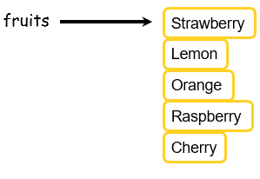
Lists representation in computer memory
It is useful to form a mental image of how lists are represented internally by the computer.
Lists can be depicted in either a horizontal or vertical fashion
The key point is that the elements of the list should be envisaged in adjoining memory locations (just like the individual characters of a string as described previously).

Slide 10
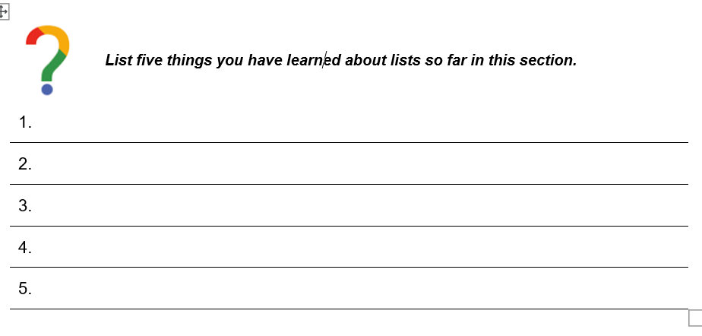

Slide 11
Indexing Lists
Strings and lists are different variable types, but elements in a list are indexed in the same way as strings.
Index | Value | Item
fruits[0] | ‘Strawberry’ | 1
fruits[1] | ‘Lemon’ | 2
fruits[2] | ‘Orange’ | 3
fruits[3] | ‘Raspberry’ | 4
fruits[4 ] | ‘Cherry’ | 5

Slide 12
Indexing Lists
It is possible to print out single items from the list.
print(fruits[0])
print(fruits[2])
print(fruits[4])
Predict what this code will do?
Run the code to check your prediction.
Modify the code to print each item in the list.

Slide 13
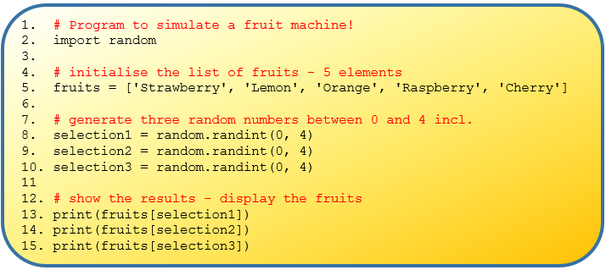
Practice Time
The next example program demonstrates how to combine the use of random numbers and lists to simulate the operation of a fruit machine.
Read the program carefully and see if you can figure out how it works.

Slide 14
Practice Time
Look up the online documentation for the Python random library.
What does the choice command do?
How might choice be used in the above program?

Slide 15
Today we covered these skills:
Understand what is a python list
Initialise a list
Understand the difference between a list and an array
Index a list

Slide 16
Today we covered these skills:
Recap on last class skills
Change the values in a list
Understand “Out of Range errors”
Use Negative indexing with lists

Slide 17
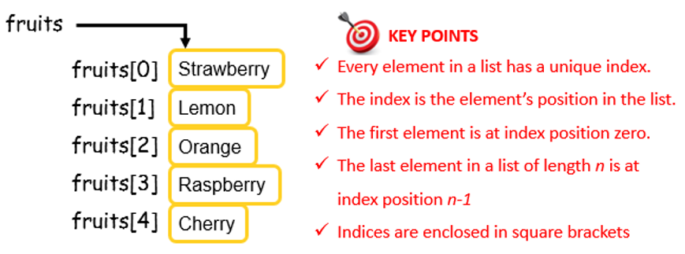
Recap on last class

Slide 18
Read the code and figure out how it works

Slide 19
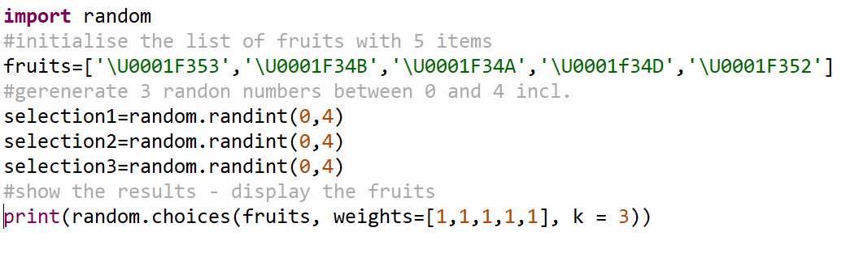
Recap on last class
How might choice from the random library be used in the following program?

Slide 20
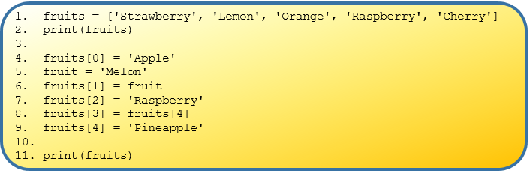
Lists are Mutable – Examine and Explain
Notes:
Line 1 initialises a list of fruits and line 2 displays the contents of the list
Lines 4-9, each make separate changes to the individual elements in the list that are ‘housed’ at the given index
Line 11 displays the list again
Predict the output of the above program.

Slide 21
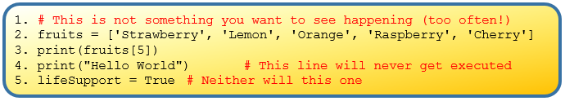
Index “Out of Range” errors

Slide 22
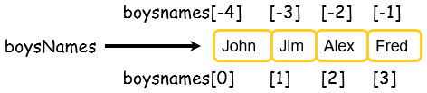
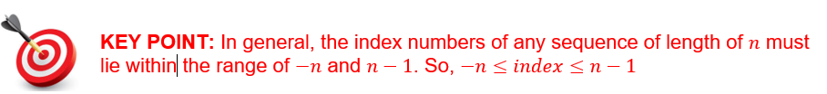
Negative Indexing

Slide 23
Today we covered these skills:
Recap on negative indexing
Implement different forms of list slicing
Understand and use different list methods

Slide 24
Negative Indexing

Slide 25
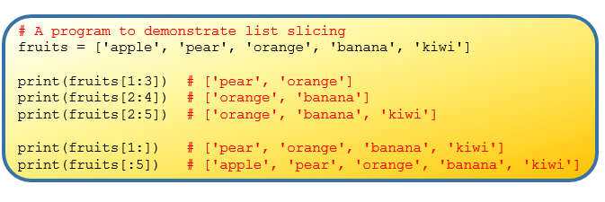
List Slicing – similar to string slicing (task3)
Notes:
Can you figure out how the program generates the output shown inside the comments?
How could we ‘slice out’ the fruits that grow in Ireland (i.e. apple and pear)?
What output would be generated from the line print(fruits[ : ])?

Slide 26
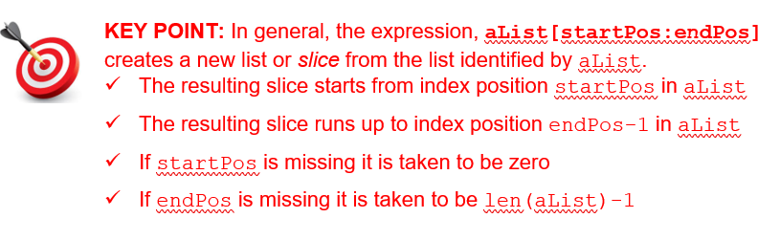
List Slicing –

Slide 27

List Slicing
A list slice is in fact a new list.
For example, the following code results in the new list being stored in the list variable exoticFruits

Slide 28
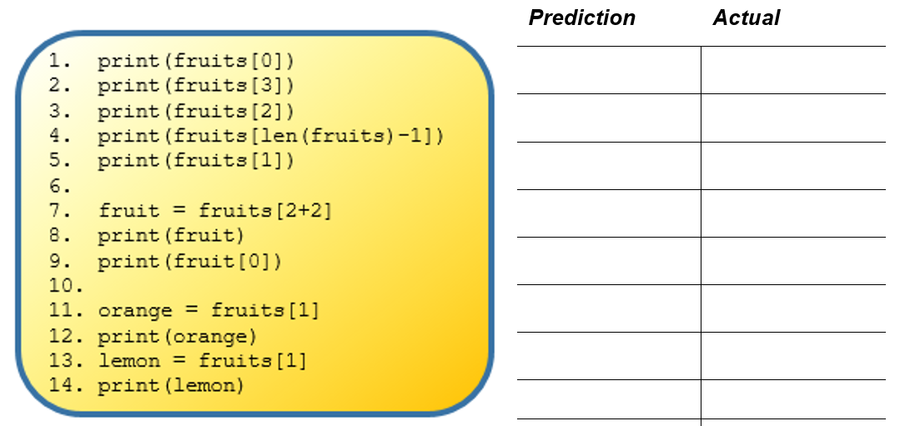
Notes:
Task 4

Slide 29

What value do you think the following expression would generate?
Notes:
Task 4

Slide 30
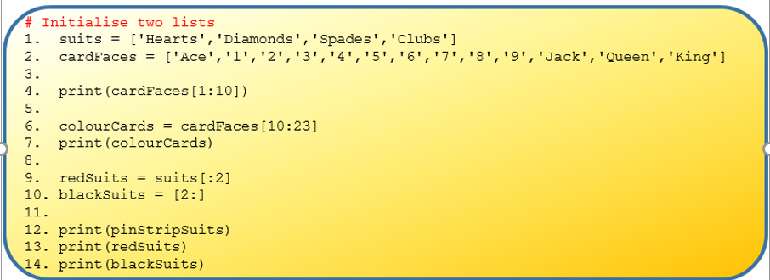
Task5 – find the error and suggest fix
Notes:
How would you extend the programs functionality to generate and display a random card
What additional issues would you have to consider if the program was required to deal a random hand of 5 cards

Slide 31
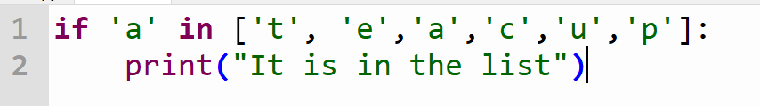
Using in and not in operators with lists
Use in and not in to check whether an item is or is not in a list.

Slide 32
Using in and not in operators with lists
Use in and not in to check whether an item is or is not in a list.
The expression has a value to look for in a list, and the list where it may be found. Evaluates to a Boolean expression

Slide 33
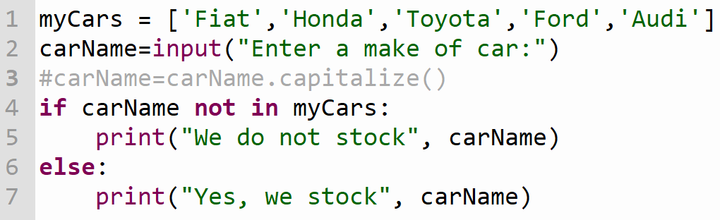
Using in and not in operators with lists
Use in and not in to check whether an item is or is not in a list.

Slide 34
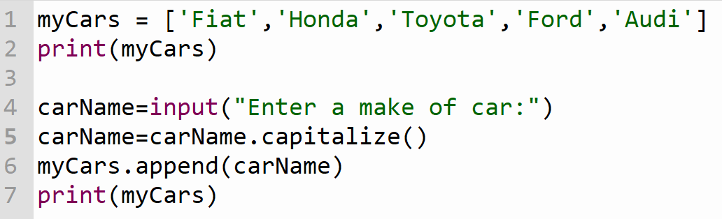
Appending an item to a list
Unlike strings, we can change individual items in a list using their index. Lists are mutable

Slide 35
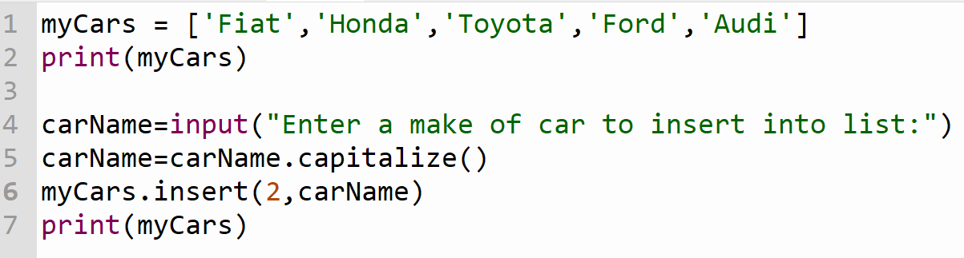
Inserting an item into a list
To insert an item into a list we use .insert(index, item)

Slide 36
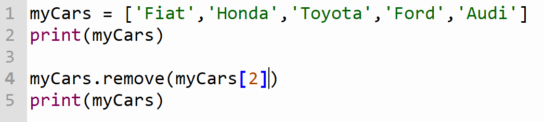
Removing an item from a list
To remove an item from a list we use .remove(listname[index])

Slide 37
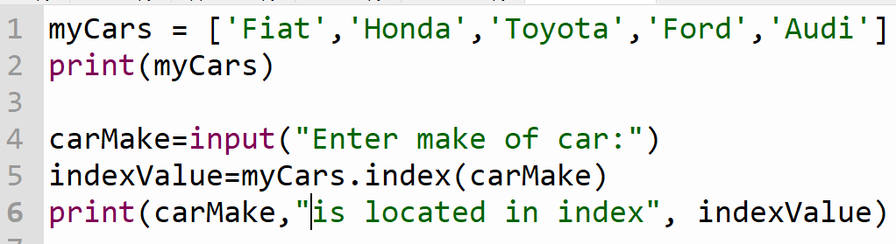
Finding the location of an item in a list
Find the location of an item in the list .index(item)
Only returns the first location

Slide 38
ITERATION: while and for loop
  Iteration occurs when we instruct the computer to carry out a task over and over again by repeating a section of code. This piece of code is called a loop.

Slide 39
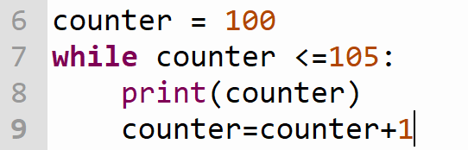
Basic while loop
  A while loop keeps repeating while a certain condition is true.

Slide 40
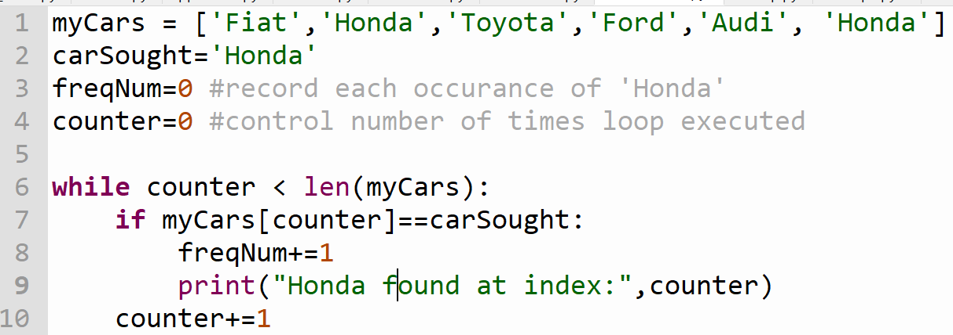
Locating items that occur more than once

Slide 41
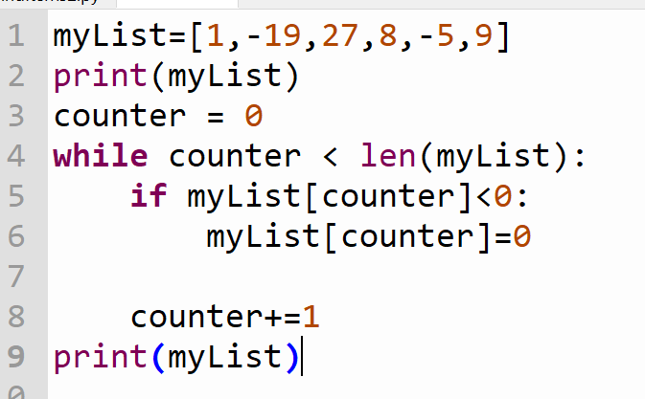
Modifying items in a list using a while loop

Slide 42
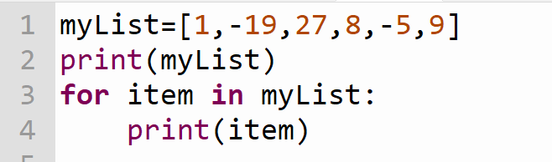
Using for loops with lists

Slide 43
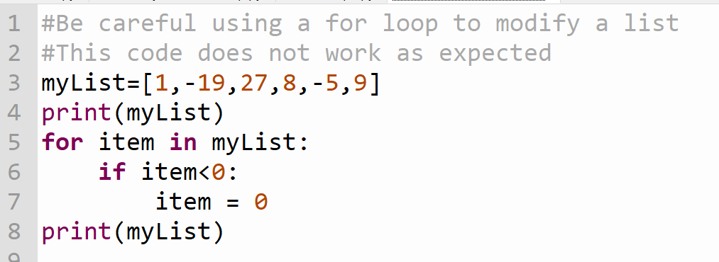
Using for loops with lists

Slide 44
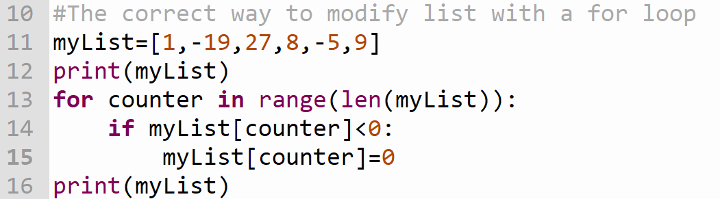
Using for loops with lists

Slide 45
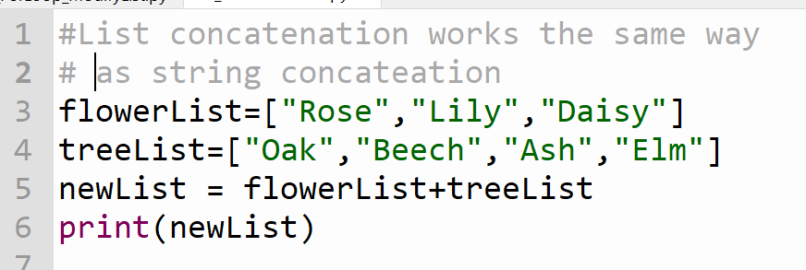
List concatenation

Slide 46
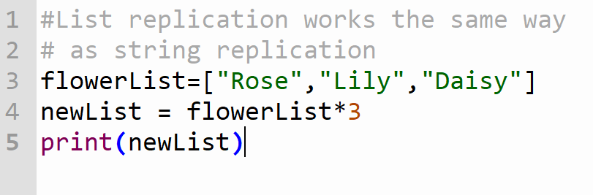
List replication

Slide 47
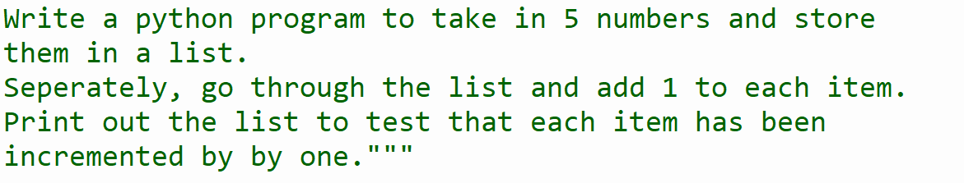

Slide 48
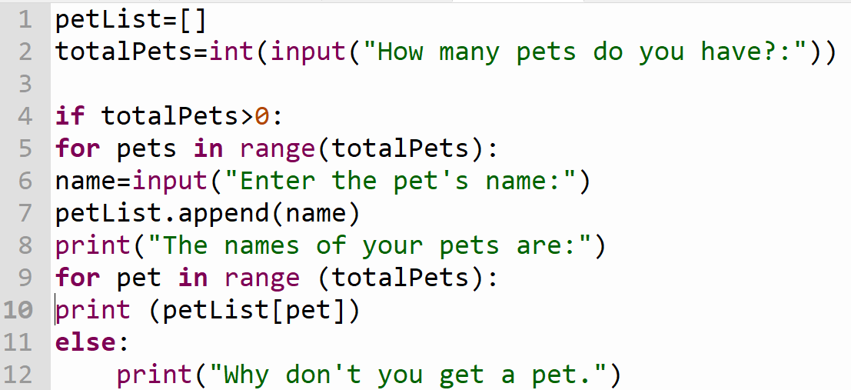
Entering items in a list

Slide 49
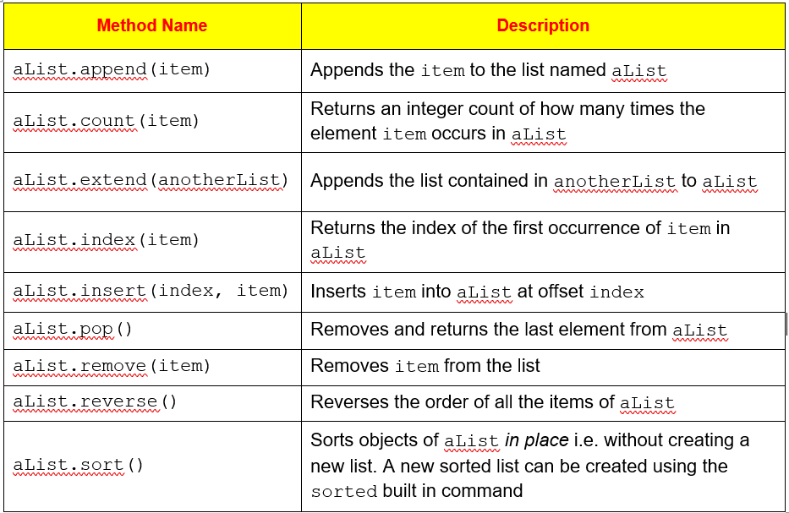

Slide 50
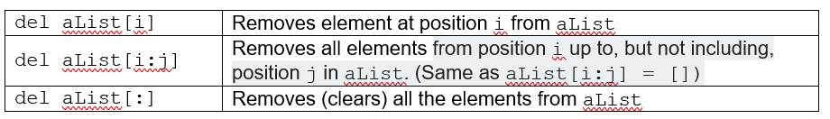
List Methods
The del keyword can also be applied to remove individual elements or entire slices from a lists. del is used in conjunction with the square bracket index operator as follows.

Slide 51
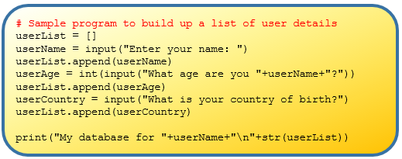
List Methods – Example 2 – Task7 exercise book
Notes:
Type up the code and run it. Can you figure out what each line of code does?
Extend the code to get the user to input their year of birth. What datatype will you use for this?
At the end of the program, display the list again but in reverse order.

Slide 52
List Methods – Task 8
Write a program which splits the pangram “The five boxing wizards jump quickly”.
Rearrange the list so that the pangram becomes “Quickly jump the five boxing wizards”. (You may ignore capitals)
Hint! You could use the pop() method to pop off the last two words and use variables to store them until you have moved along the other four words.

